Slide 1
SAP Process Integration
2
Application Environment
Adapter Framework

Slide 2

PI Adapter Framework
Agenda
SAP PI Adapter Framework Overview
Technical adapters in detail
Summary

Slide 3
SAP PI Architecture
Integration Repository / Integration Directory / System Landscape Directory
Content (e. g. Mapping, Adapter Metadata)
Integration Server
Business Process Engine
Integration Engine
Partner Connectivity Kit
Plain
J2SE Adapter Engine
Central Adapter Engine
Optional Decentral Adapter Engine
PCK Configuration
and Monitoring
Adapter Framework
Messaging Queuing Security Handling
Resource Adapter
Adapter FW
Messaging Queuing Security Handling
Adapter FW
Messaging Queuing Security Handling
IDoc Adapter
Resource Adapter
Resource Adapter
Adapter
File DB JMS
SAP System
File/DB/JMS
Marketplace
3rd Party Sys.
File/DB/JMS
Marketplace
3rd Party Sys.
File/DB/JMS
SAP System

Slide 4
SAP PI Architecture
Integration Repository / Integration Directory / System Landscape Directory
Content (e. g. Mapping, Adapter Metadata)
Integration Server
Business Process Engine
Integration Engine
Partner Connectivity Kit
Plain
J2SE Adapter Engine
Central Adapter Engine
Optional Decentral Adapter Engine
PCK Configuration
and Monitoring
Adapter Framework
Messaging Queuing Security Handling
Resource Adapter
Adapter FW
Messaging Queuing Security Handling
Adapter FW
Messaging Queuing Security Handling
IDoc Adapter
Resource Adapter
Resource Adapter
Adapter
File DB JMS
SAP System
File/DB/JMS
Marketplace
3rd Party Sys.
File/DB/JMS
Marketplace
3rd Party Sys.
File/DB/JMS
SAP System

Slide 5
Adapter Framework based on SAP J2EE Engine
Adapter Framework provides common functionality for Adapter Engine and SAP Partner Connectivity Kit
Adapter Framework is based on SAP J2EE Engine as part of SAP Web AS
Adapter Framework inherits properties and features such as scalability, clustering, high availability, thread management, etc.
Adapter Framework provides its own queuing and logging services
Temporary stand-alone operation without connection to an Integration Server is possible, while still providing e. g. guaranteed exactly once messaging to and from connected application system.
Additionally Adapter Framework provides comprehensive integration for central configuration, administration, monitoring of deployed adapters.

Slide 6
JCA enabled Adapter Framework
Adapter Framework supports J2EE Connector Architecture (JCA)
JCA is standard architecture for connecting the J2EE platform to Enterprise Information Systems (EIS), e. g. ERP, DBMS, etc.
A Resource Adapter plugs into an application server, providing connectivity between the EIS and a Java application
JCA enabled Adapter Framework provides defined interfaces to which both our adapters and 3rd party adapters can conform
JCA is a widely accepted standard that 3rd party adapter providers are familiar with

Slide 7
Adapter Engine
The Adapter Framework is the basis of the Adapter Engine.
Adapter Engine is used to connect the Integration Engine to SAP systems and other systems. Various adapters are used in the Adapter Engine to convert XML- and HTTP-based messages to the specific protocol and format required by these systems.
Runtime components that use adapters to connect external systems and R/3 systems to the Integration Server by means of RFC calls.
An Adapter is used to communicate to Legacy or SAP system with Web AS version <6.20, A direct system connection using proxies and without adapters is supported for SAP systems that are based on SAP Web Application Server 6.20 or higher.

Slide 8
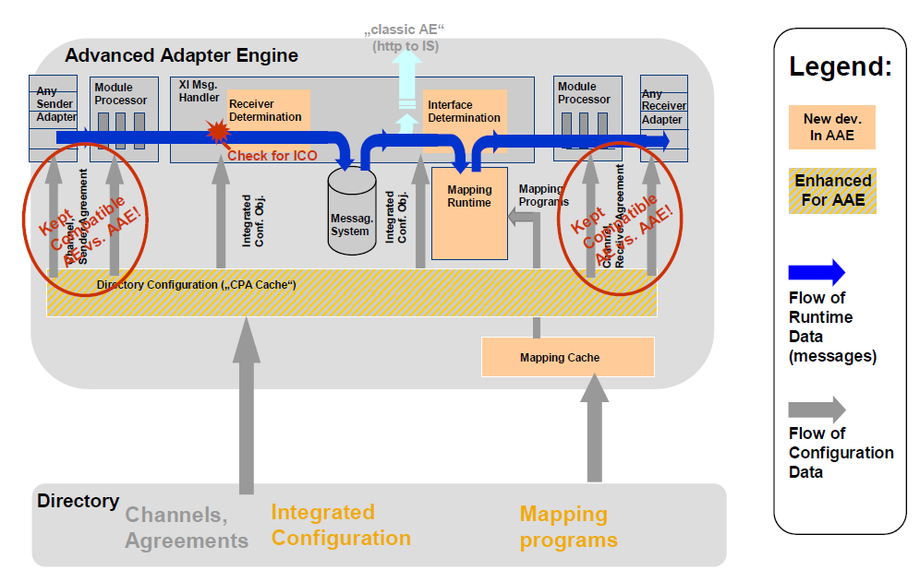
Advanced Adapter Engine in SAP PI7.1

Slide 9
SAP PI7.1 Features
With Advanced Adapter Engine (AAE), messages can be sent asynchronously as well as synchronously.
ccBPM is not supported as this is a service provided by ABAP stack
ABAP Mapping is not supported
SAP PI 7.1 supports adapter to adapter messaging thus bypassing the ABAP stack of Integration server altogether. This is known to improve performance by a factor of 10.
High Volume Support and increases message processing speed, throughput by reducing latencies and resource consumption(both memory and processing time)
The AAE is available centrally and non-centrally.
Runs on Java EE 5

Slide 10
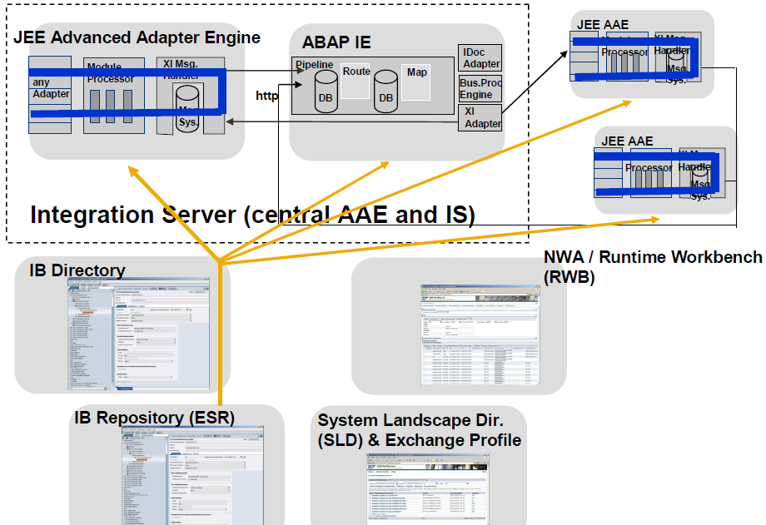
SAP NW PI 7.1 Landscape

Slide 11
Full integration of Adapter Engine in SAP PI landscape
Adapter Engine fully integrated with the SAP XI landscape
Central configuration of connections to application systems (through appropriate adapters) in Integration Directory
Reuse of Integration Directory’s existing versioning and transport capabilities
Central administration and monitoring over adapters, Integration Server, Integration Engine through Runtime Workbench

Slide 12
Central and Decentral Adapter Engine
Adapter Engine is open for adapter development by partners and customers
JCA based adapter development as ‘state-of-the-art’ Java technology
Additional services for configuration, monitoring, security etc.
SAP XI Adapter Framework (as PCK), Adapter Framework Interface Specification, JCA sample adapter (incl. source code) available via SAP Integration and Certification Center
The Adapter Engine can be deployed centrally as part of Integration Server, or as optional decentral Adapter Engine on its own SAP J2EE Server
Use of decentral Adapter Engine e. g. to be close to business system

Slide 13
SAP PI Adapter Partner System
SAP relies on a system of partners to provide adapters for other applications and certain industry standards
Adapter Reseller Agreement
iWay Software
UCCnet
Swift Adapters
SEEBURGER AG
EDI Adapters like AS2 etc
WebMethods
Applications (Oracle, Siebel, PeopleSoft, Baan, …)
Partner adapters are sold and delivered through SAP
Technical Support
SAP provides 1st level support
Partners provide 2nd and 3rd level support

Slide 14
SAP PI Architecture
Integration Repository / Integration Directory / System Landscape Directory
Content (e. g. Mapping, Adapter Metadata)
Integration Server
Business Process Engine
Integration Engine
Partner Connectivity Kit
Plain
J2SE Adapter Engine
Central Adapter Engine
Optional Decentral Adapter Engine
PCK Configuration
and Monitoring
Adapter Framework
Messaging Queuing Security Handling
Resource Adapter
Adapter FW
Messaging Queuing Security Handling
Adapter FW
Messaging Queuing Security Handling
IDoc Adapter
Resource Adapter
Resource Adapter
Adapter
File DB JMS
SAP System
File/DB/JMS
Marketplace
3rd Party Sys.
File/DB/JMS
Marketplace
3rd Party Sys.
File/DB/JMS
SAP System

Slide 15
SAP Partner Connectivity Kit Overview (1)
SAP Partner Connectivity Kit (PCK) is based on Adapter Framework
PCK‘s objective is to enable XML document exchange between SAP PI and business partner not using SAP PI
Communication between SAP PI and PCK is via SAP PI messaging protocol
PCK provides connectivity options to access:
SAP Adapters
File / FTP
JDBC (Database)
JMS (MQSeries, SonicMQ, …)
SOAP
RFC

Slide 16
SAP Partner Connectivity Kit Overview (2)
PCK is deployed on stand-alone SAP J2EE Engine (part of SAP Web AS) within business partner’s landscape
Configuration, administration, monitoring done locally on PCK itself without need for an Integration Directory
Configuration UI provides “same look and feel“ as configuration UI of Adapter Engine

Slide 17
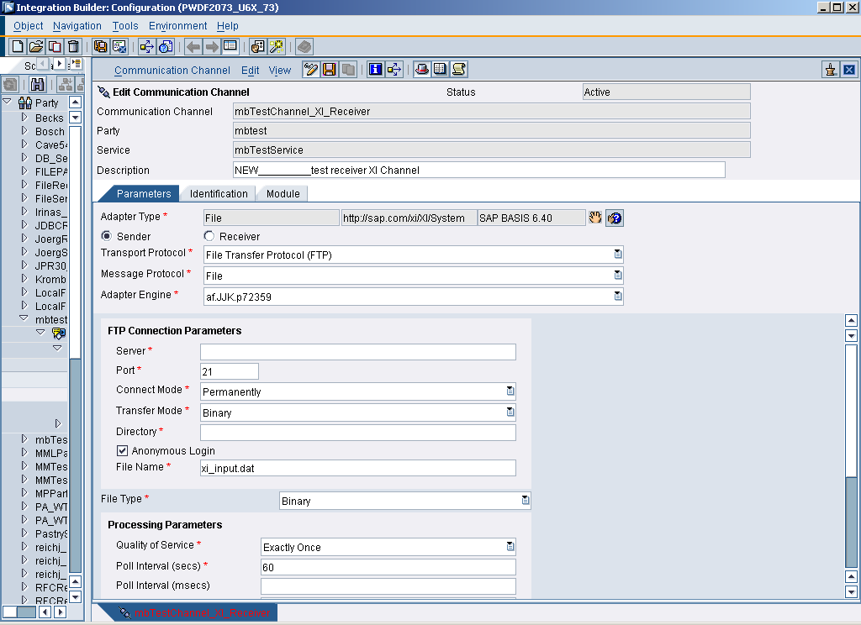
Adapter Configuration
Adapter independent parameters
Adapter specific parameters

Slide 18
Quality of Service(QoS)
The sender of a message uses the attribute Quality of Service (QoS) to determine how a message is delivered. The following types of quality of service are supported:
● BE (Best Effort): The message is sent synchronously. The sender waits for a response before it continues processing.
● EO (Exactly Once): The message is sent asynchronously. The sender does not wait for a response. The Integration Engine and the Adapter Engine guarantee that the message is sent and processed exactly once.
● EOIO (Exactly Once In Order): Messages are delivered with the same queue names (supplied by the application) in the same sequence that they were sent from the sender system. Message processing is asynchronous in this case.
In the case of quality of service BE an error occurs if more than one receiver is determined for a message. In the case of delivery types EO and EOIO, the message is copied correspondingly and sent to the individual receivers.
Synchronous Message Processing (BE)
Asynchronous Message Processing (EO, EOIO)

Slide 19
PI Adapter Framework
Agenda
SAP PI Adapter Framework Overview
Technical adapters in detail
Summary

Slide 20
Technical adapters in detail
This section will give an overview of the functionality and usage of each technical adapter delivered with PI
RFC
IDoc
File
JDBC
JMS
Plain HTTP
SMTP
SOAP

Slide 21
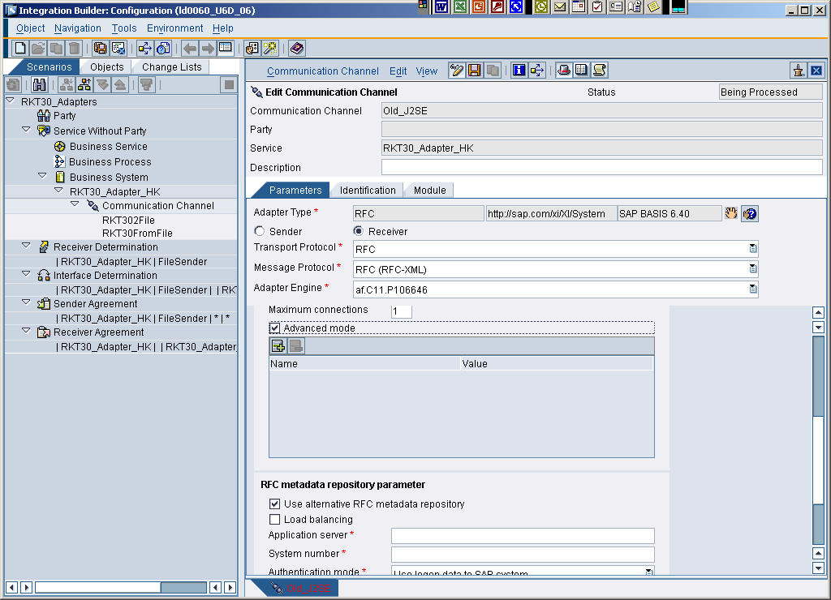
RFC Adapter

Slide 22
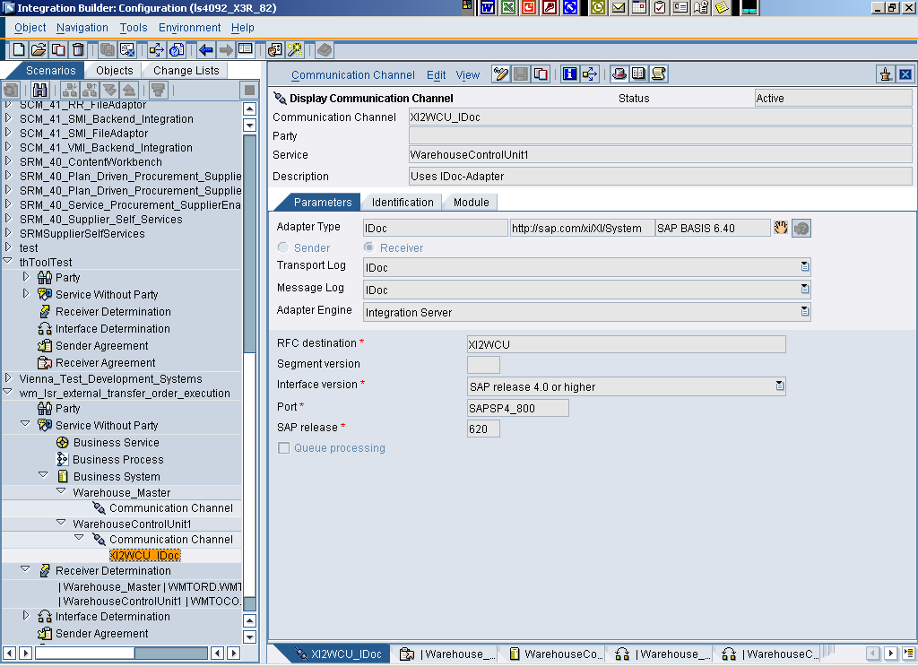
IDoc-Adapter
Notes:
IDoc-Adapter: only receiver communication channel is used
Type IDoc
Exception for „normal IDoc-Processing“: report“IDX_SELECT_IDOCTYP_WITHOUT_IS“
Module Processor not used

Slide 23
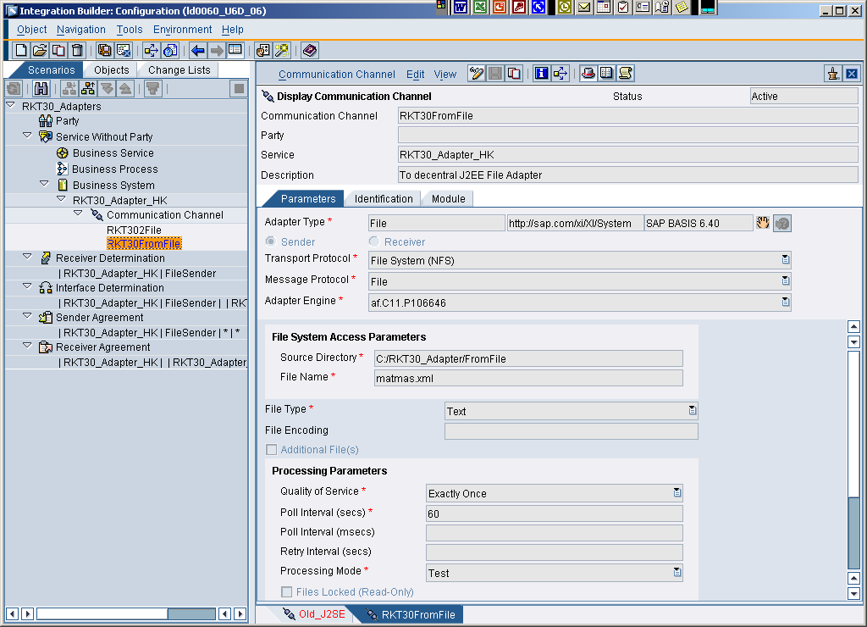
File Adapter

Slide 24
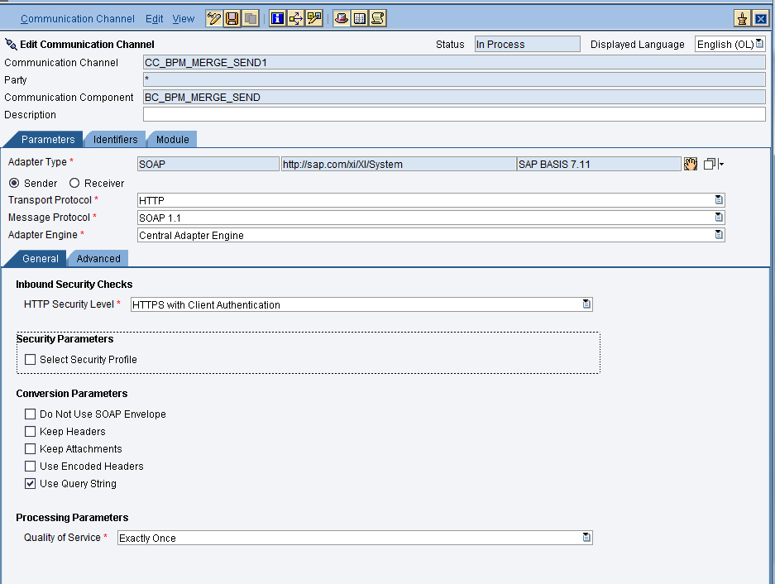
SOAP Adapter

Slide 25
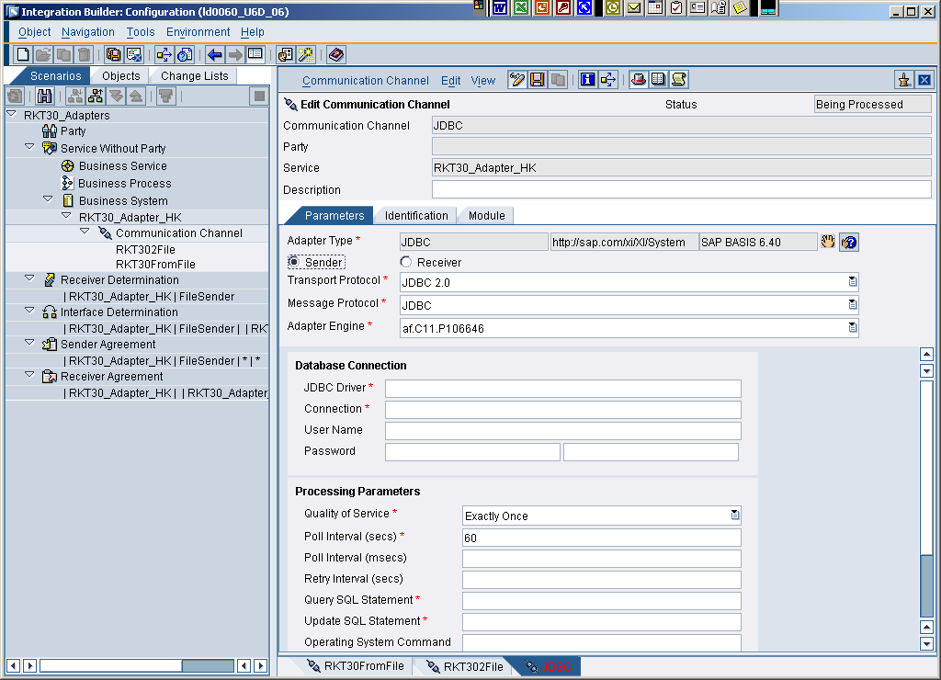
JDBC Adapter

Slide 26
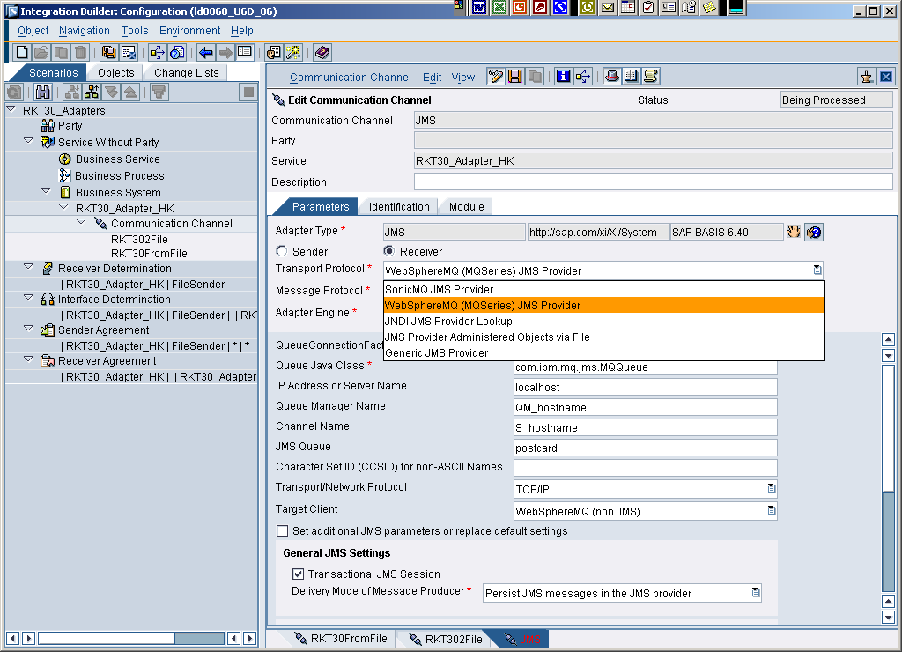
JMS Adapter

Slide 27
PI Adapter Framework
Agenda
SAP PI Adapter Framework Overview
Technical adapters in detail
Summary

Slide 28
Summary
Adapter Framework runs on J2EE Stack of SAP Web AS
Adapter Framework is platform for Adapter Engine and PCK
Adapter Framework provides an extensible platform for developing and running adapters in SAP PI environment
Adapter Engine utilizes central configuration, monitoring, administration
Dual connectivity strategy
Adapter Framework for comprehensive integration of adapters
Interoperability via open standards to interop. with EAI providers
SAP NetWeaver Certification for adapters based on Adapter Framework available
Adapter mappings, metadata stored in Integration Repository

